Slide 1
Secure Access to an EJB3.0

Slide 2
The following slides describes the EJB3 Security. There two aspects of EJB3 Security: Authentication and Authorization
Authorization(namely restricting access to bean methods to a given role or roles).
The following example illustrate the concept of EJB3 security in JBOSS server.
Step 1: update login-config.xml with security policy details
Step2 : create users.properties and roles.properties files under myProps folder
Step3: create a Remote/Local interface
Step4: create a Session Bean
Step5: write the Client program to access the EJB

Slide 3
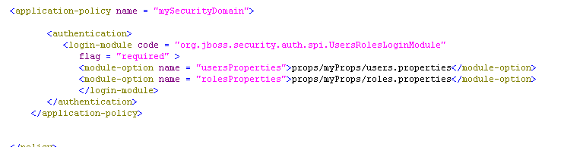
Login-config.xml

Slide 4


users.properties and roles.properties

Slide 5
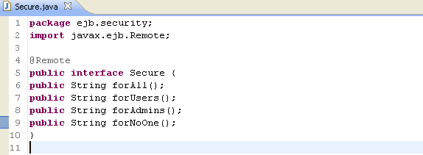
Remote Interface

Slide 6
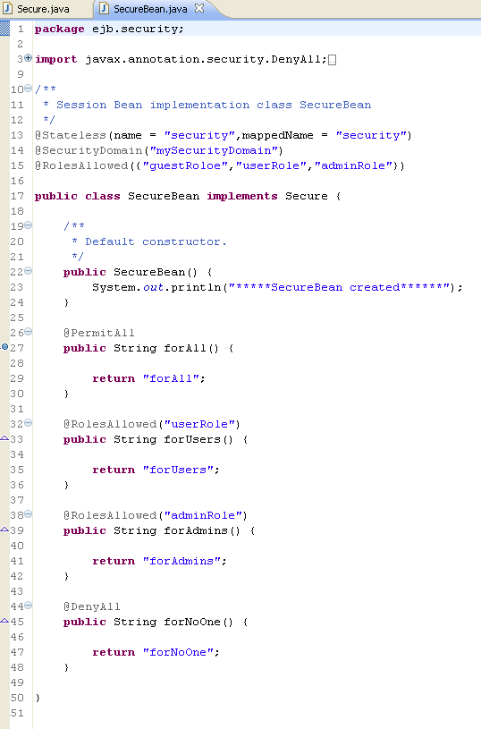
Session Bean

Slide 7
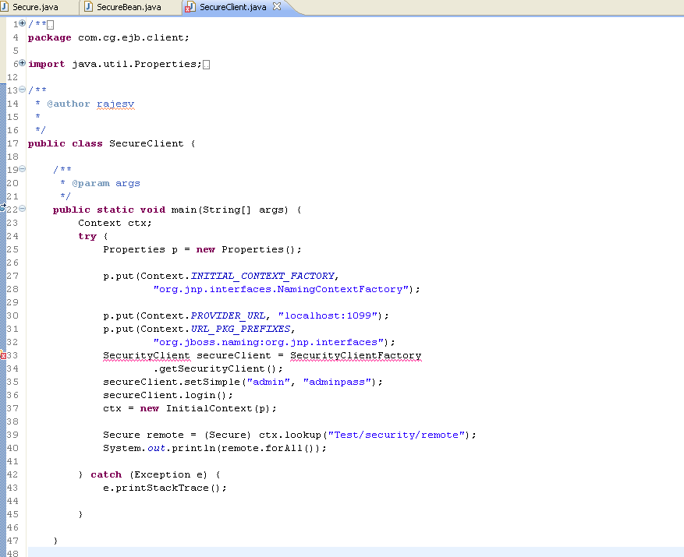
Secure Client (EJB Client)

